Slide 1

MTP-2
Hardware Accelerated Network Traffic Analytics
Baddala Sai Kumar Reddy
Mailavaram Parthasaradhi Reddy
Department of Computer Science and Engineering
Guided By
Prof.Ayon Chakraborty
November 2024

Slide 2
Contents
Problem Statement
Introduction
Overview of FPGA and PYNQ-Z2 board
Zynq Architecture
Processing System (PS) and Programmable Logic (PL)
Setting Up the PYNQ-Z2 Board
Steps for board setup and configuration
Hello LED Program on PYNQ-Z2
Code walkthrough and explanation
Understanding AXI Interfaces
AXI Lite and AXI Stream
Simple Adder Example
Data flow and code implementation
Performance Comparison: CPU vs FPGA
Image dimming example
Running Neural Networks on FPGA
Simulation of MNIST MLP with ZyNet
Current Simulation Results
How AI acclerated NIC works?
Conclusion and Future Work
Summary and next steps for MTP Phase 2

Slide 3
Problem Statement
Objective:
The goal is to implement real-time network traffic analytics for tasks such as packet identification, traffic classification, and anomaly detection to enhance network security and performance.
Challenges with Traditional Routers for Network Traffic Analytics:
High Latency
Scalability Issues
1
2
3
4
Limited Processing Power
Increased Load
Solution:
Develop an AI-Accelerated NIC: Creating an embedded Linux platform that functions as an AI-driven Network Interface Card (NIC) capable of handling network traffic analytics in real time. This dedicated solution offloads analytics tasks from routers, reduces latency, and leverages FPGA resources for efficient processing

Slide 4
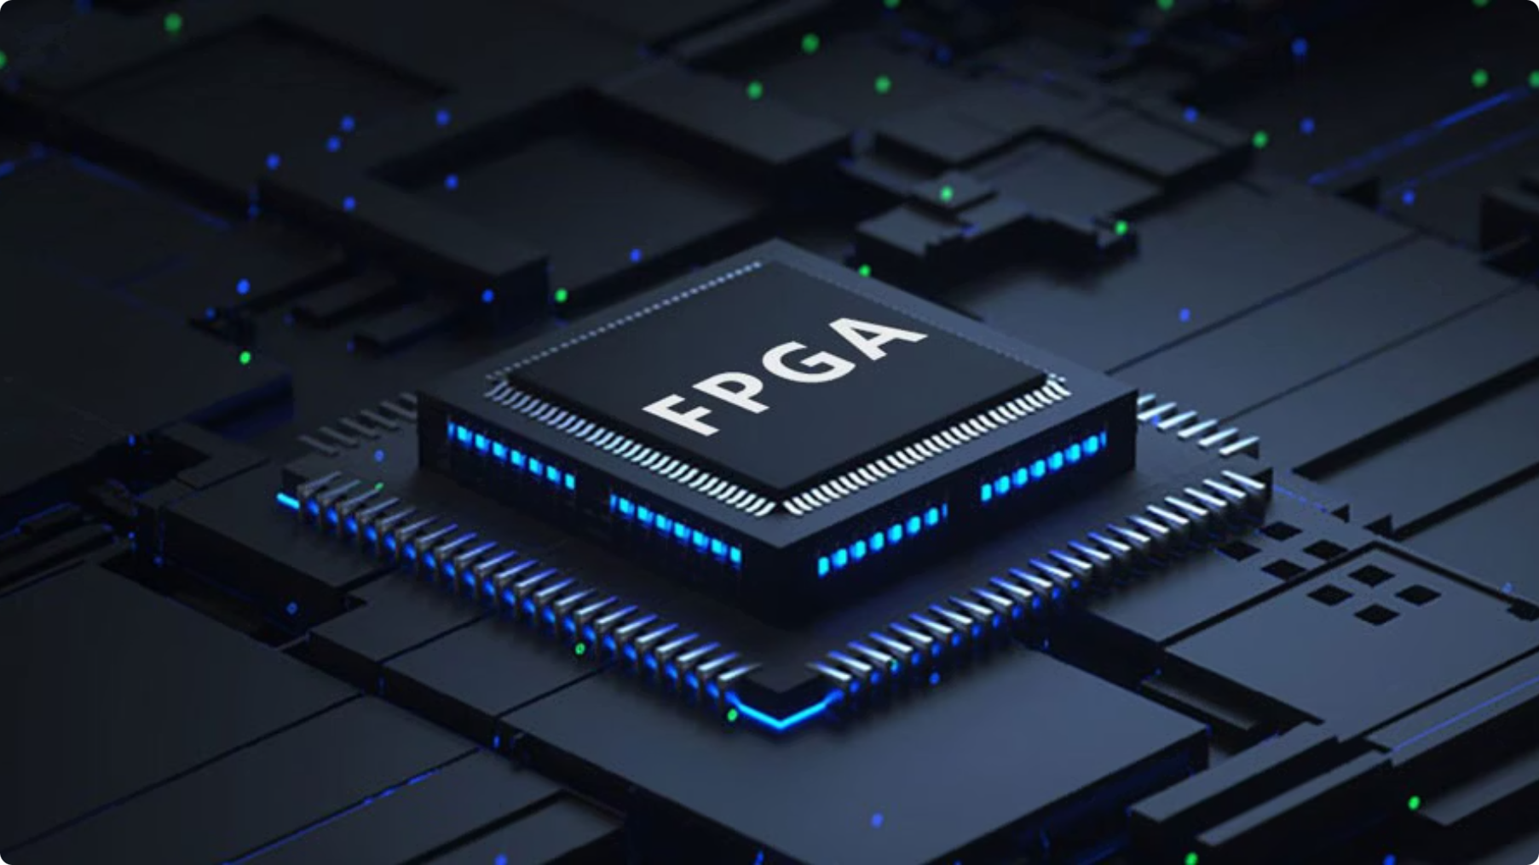
Understanding FPGA and PYNQ-Z2 board

Slide 5
What is an FPGA?
A reconfigurable integrated circuit that can be programmed to perform specific tasks.
Parallelsim
Customizability
Hardware Acceleration
What is the PYNQ-Z2 Board?
Development Platform: The PYNQ-Z2 board is built on the Xilinx Zynq-7020 architecture, combining a dual-core ARM Cortex-A9 Processing System (PS) with programmable FPGA logic (PL).
Runs a Linux-based operating system, such as Ubuntu.
Customizable hardware block for specific processing tasks.
Includes HDMI, Audio, GPIO, and Ethernet, making it suitable for a range of applications from signal processing to machine learning.

Slide 6
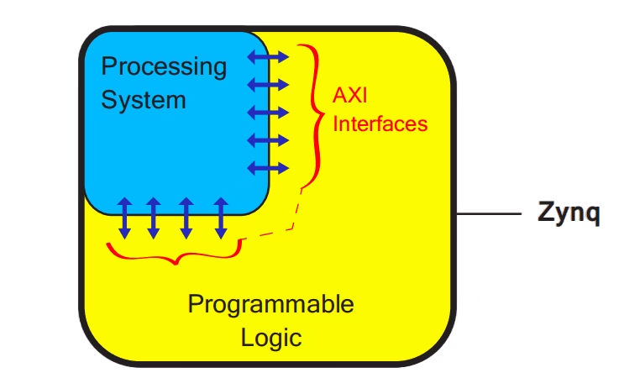
Zynq Architecture
Processing System (PS):
Contains a Dual-core ARM Cortex-A9 processor.
Programmable Logic (PL):
Configurable FPGA fabric.
AXI Interfaces:
AXI (Advanced eXtensible Interface) bridges the PS and PL

Slide 7





Setting Up the PYNQ-Z2 Board
Insert MicroSD Card
Place the microSD card containing the PYNQ image into the board's SD card slot.
Connect Power
Plug in the power adapter and turn on the board. The LEDs will light up as the board boots.
Network Connection
Connect the Ethernet cable from the PYNQ-Z2 board to your local network.
Find IP Address
Use a network scanner to locate the board's IP address.
Access Jupyter Interface
Open Jupyter by entering the IP address in a web browser
http://<PYNQ-Z2_IP_ADDRESS>

Slide 8
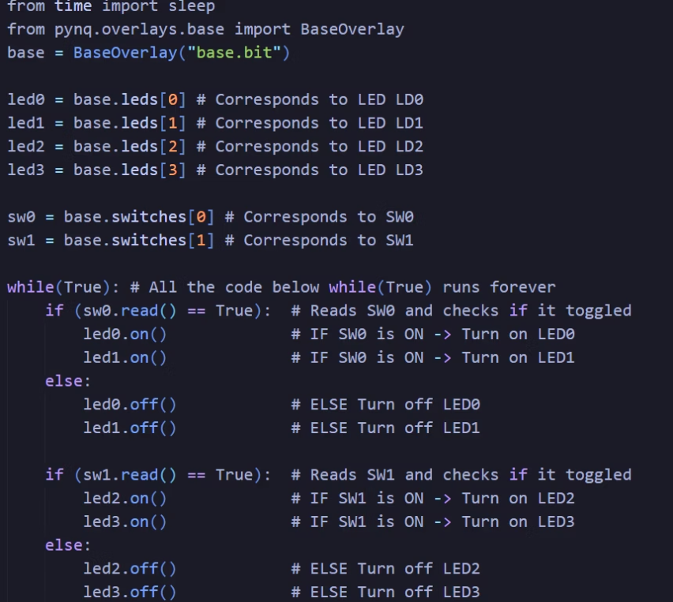
Let’s Light It Up! The Hello LED Program on PYNQ-Z2

Slide 9
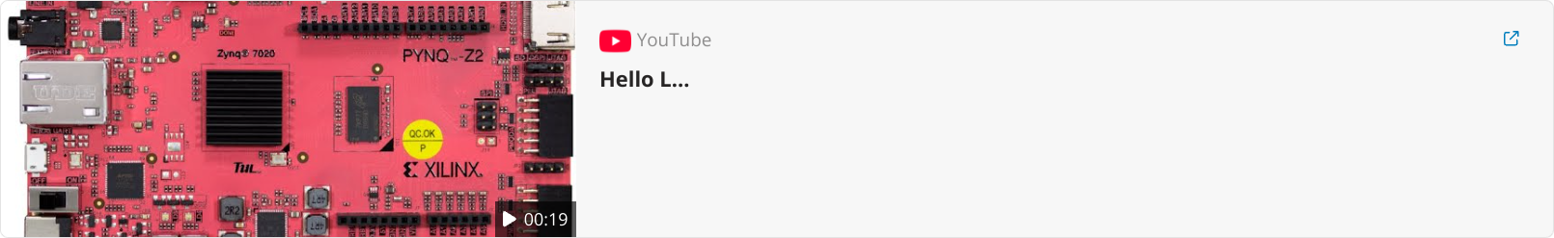

Slide 10
Getting to Know AXI Interfaces: The Heart of Data Flow
AXI, or Advanced eXtensible Interface, is a crucial communication protocol for data exchange within the Zynq architecture.
AXI is part of ARM's AMBA (Advanced Microcontroller Bus Architecture) protocol suite. Designed for high-performance data transfer with low latency, AXI enables seamless communication between the Processing System (PS) and Programmable Logic (PL) in System on Chips (SoCs) like the Zynq.

Slide 11
Types of AXI Interfaces
AXI Stream
AXI Lite
Optimized for high-speed, unidirectional data streaming, ideal for large data transfers.
Lightweight interface ideal for low-bandwidth
Single data transactions
For continuous data like video, audio, or sensor data.
Ideal for applications such as configuring control registers.
Ideal for video and image processing pipelines, audio streaming, and high-speed networking.
Considering AXI interface types is crucial for this AI-accelerated NIC framework.
AXI Stream is essential for high-speed, unidirectional data flow, making it ideal for continuous packet processing in network analytics.

Slide 12
Connecting the Dots: Simple Adder with AXI GPIO
Processing System (PS) Side
1
The Processing System (PS) acts as the brain of the operation, handling the initial data input and receiving the final output. The PS receives input values (operands) from the user, typically through a Python code in a Jupyter Notebook environment.
2
AXI GPIO Interface
The PS leverages the AXI GPIO interface to send these input values (operands) to the Programmable Logic (PL) for processing. This interface facilitates a simple communication pathway between the PS and PL.
Programmable Logic (PL) Side
3
On the PL side, a custom hardware adder module awaits the input operands from the PS via AXI GPIO. This adder module executes the addition operation, computing the sum of the input values.
4
Result Output
After the sum is calculated, the PL sends the result back to the PS through GPIO, completing the data flow loop. The PS then can access the output value and display it to the user, completing the data processing operation.

Slide 13
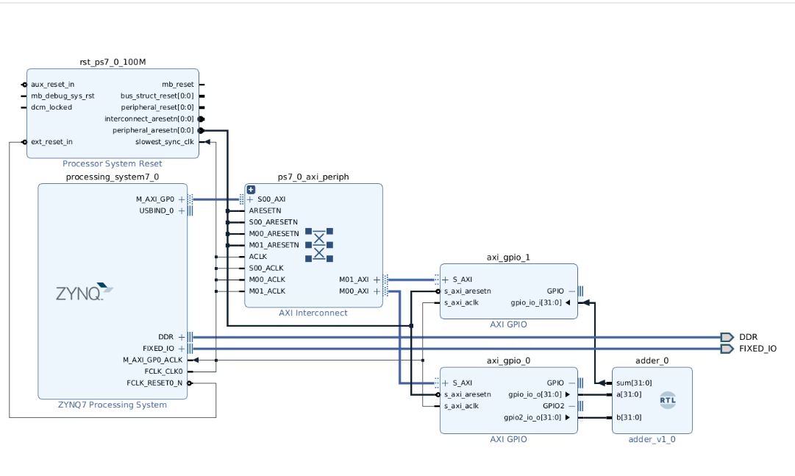
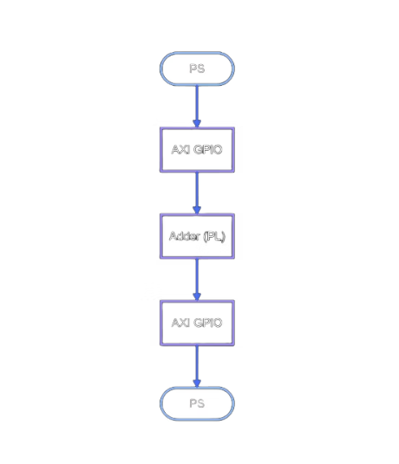
Block Design of GPIO-Enabled Custom Adder Implementation in Zynq Architecture

Slide 14
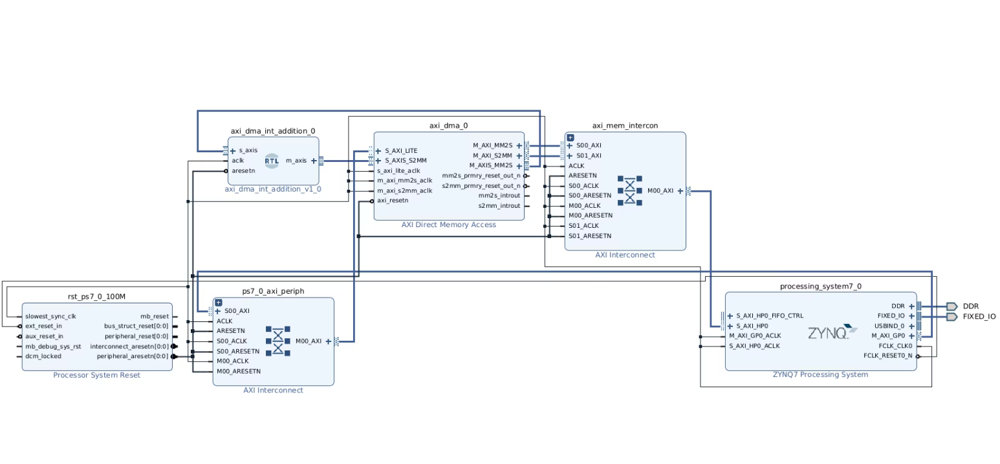
Block Diagram of DMA-Enabled Custom Adder Implementation in Zynq Architecture

Slide 15
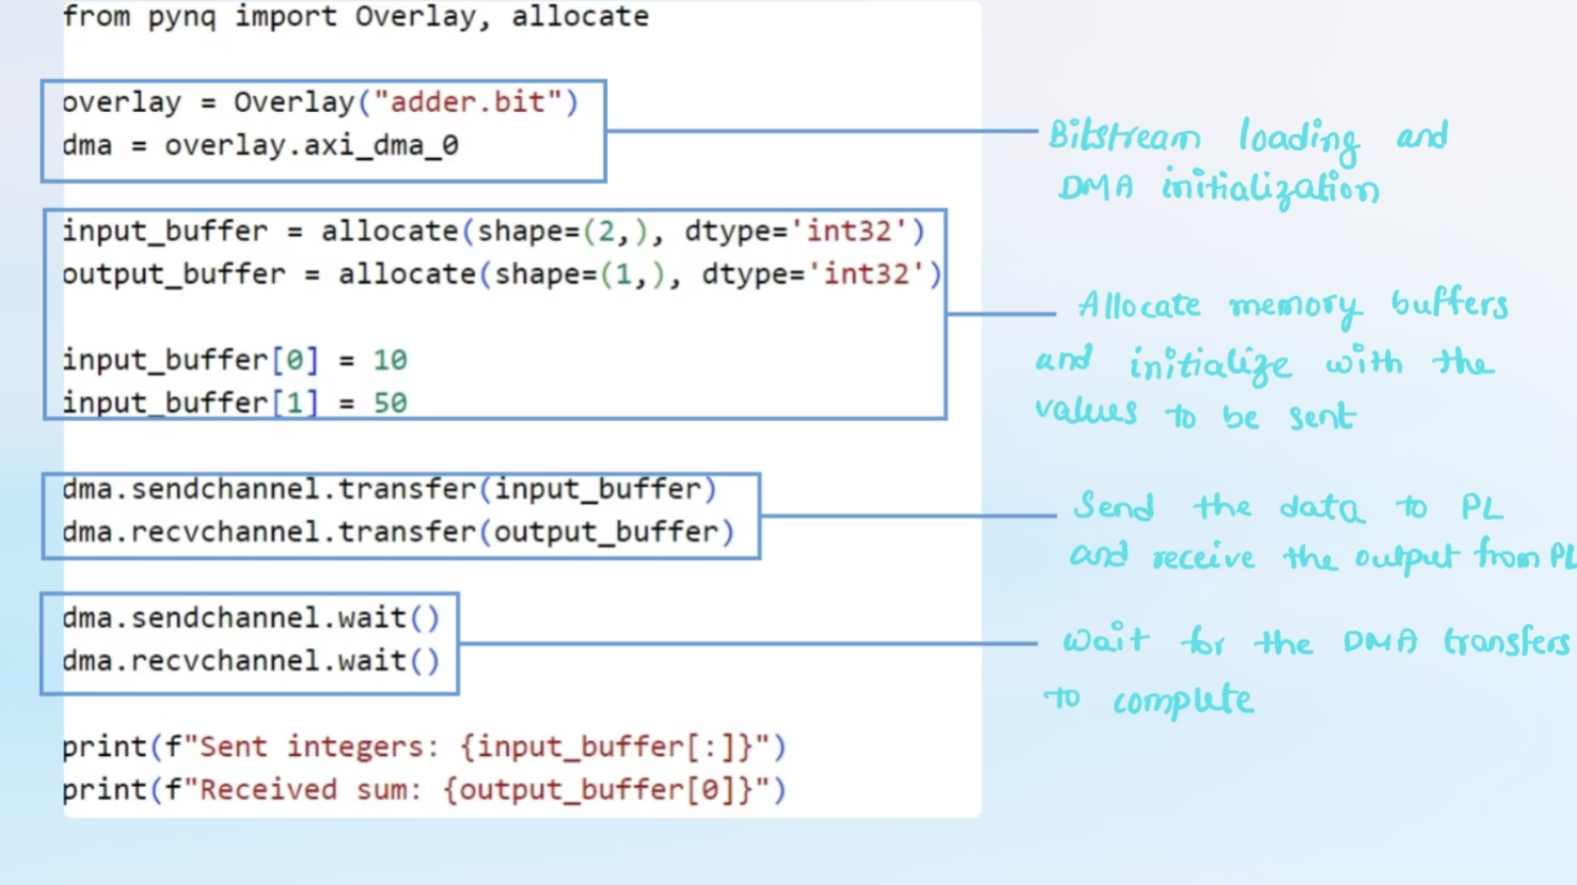

Slide 16
CPU vs. FPGA: Hardware Acceleration in Action

Slide 17

Now, let's see an image processing application where we dim 50 images on both the CPU and FPGA.

Slide 18


Image Dimming: Reducing Pixel Intensity
Original Image
Dimmed Image

Slide 19
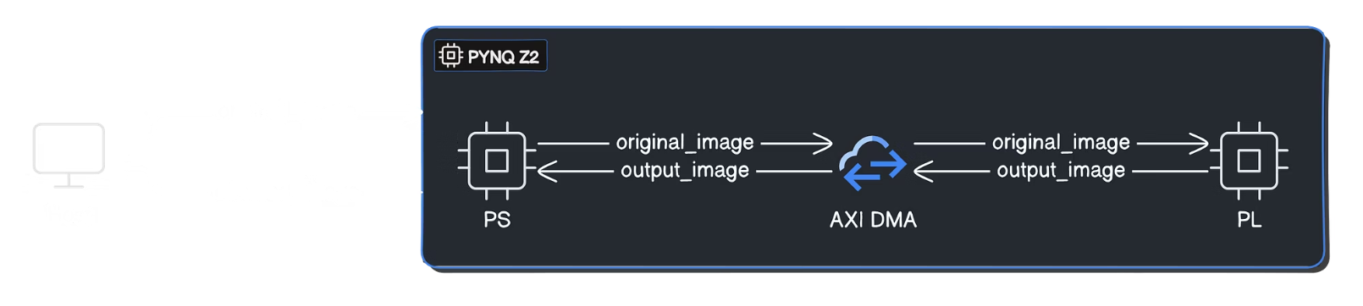
Image Dimming Pipeline on PYNQ-Z2: Host to FPGA Flow

Slide 20
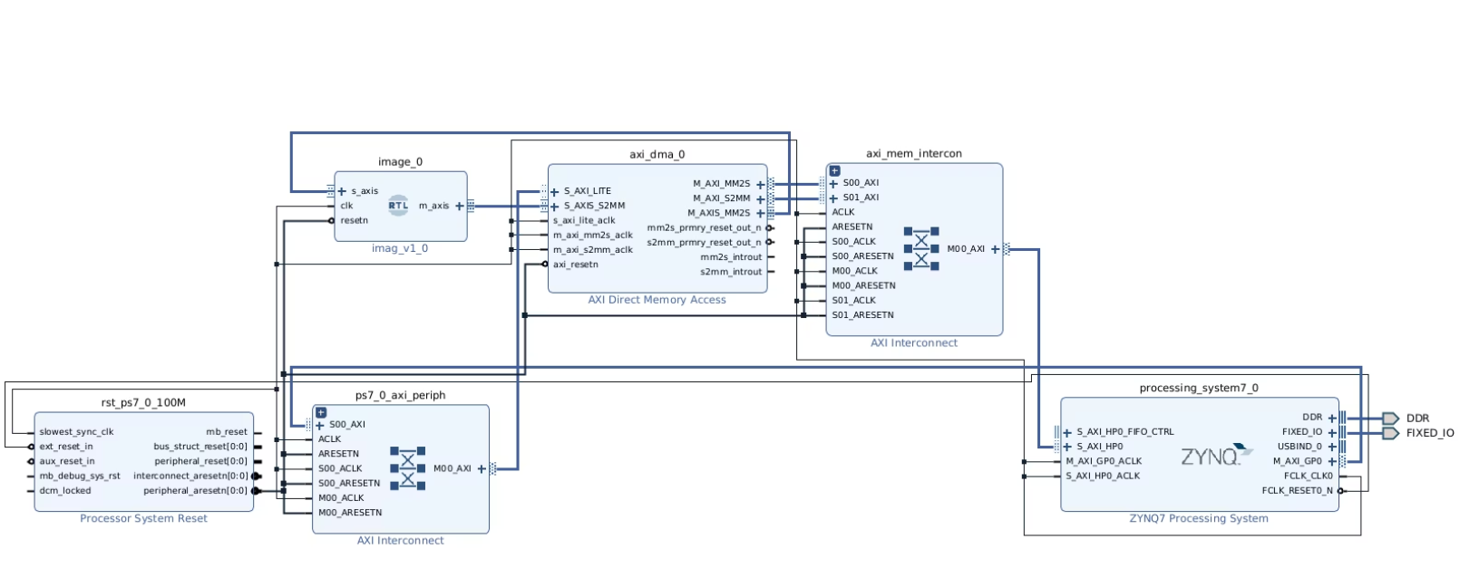
Block Design of DMA-Enabled Image Dimming Implementation in Zynq Architecture

Slide 21
Key Components in the Image Dimming System
PS (Processing System)
1
The PS manages socket communication to receive and send images from a host computer.
It controls the transfer of data between the PS and the custom logic (PL) through the AXI DMA interface.
2
AXI DMA
The DMA has two main channels: MM2S and S2MM.
The MM2S channel transfers image data from the PS’s memory to the custom IP.
Custom IP (Image Dimming)
3
The custom Verilog IP block performs the image dimming operation.
The S2MM channel transfers processed data (dimmed image) from the PL to the PS’s memory.
It receives the image data from the AXI DMA and reduces the intensity of each pixel by half.
4
AXI Interconnect
After processing, the dimmed image is sent back to the PS via the AXI DMA.
The AXI Interconnect links the AXI DMA, the custom IP, and the PS.
It ensures the correct flow of data between the different components.

Slide 22
Performance Metrics: CPU vs. FPGA
57.31
12.09
CPU Time
FPGA Time
Seconds
Seconds
3.8M
18M
CPU Throughput
FPGA Throughput
Bytes/Second
Bytes/Second
The FPGA was nearly 5 times faster than the CPU in terms of processing time, while the FPGA's throughput was over 4 times higher. This demonstrates the FPGA's advantage in computationally intensive applications.

Slide 23



Hardware Acceleration for Image Processing
Edge Detection
Identify edges or boundaries in an image for feature extraction and object recognition.
Filtering
Enhance or manipulate images by applying filters to remove noise, sharpen edges, or adjust color balance.
Real-Time Video Processing
Process video streams in real-time for applications like surveillance, autonomous navigation, and medical imaging.

Slide 24
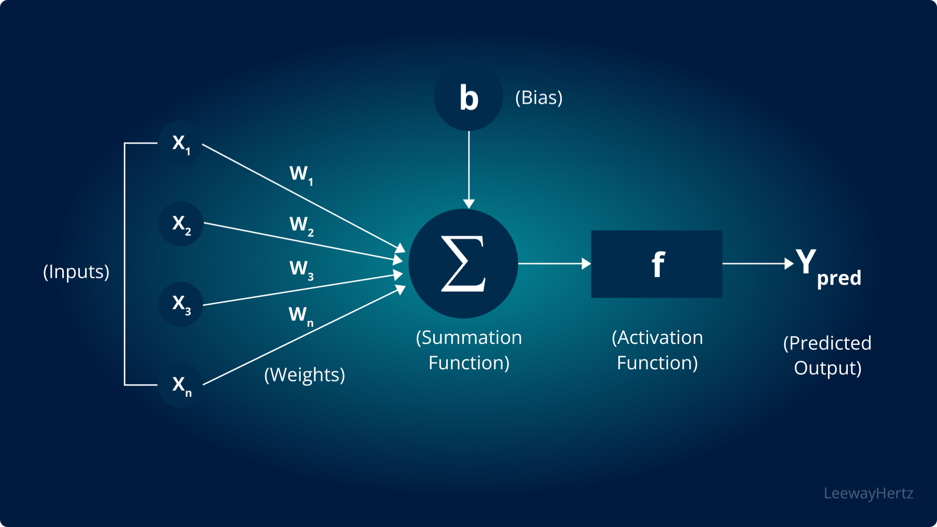
Running Neural Networks on FPGA: MNIST with ZyNet

Slide 25
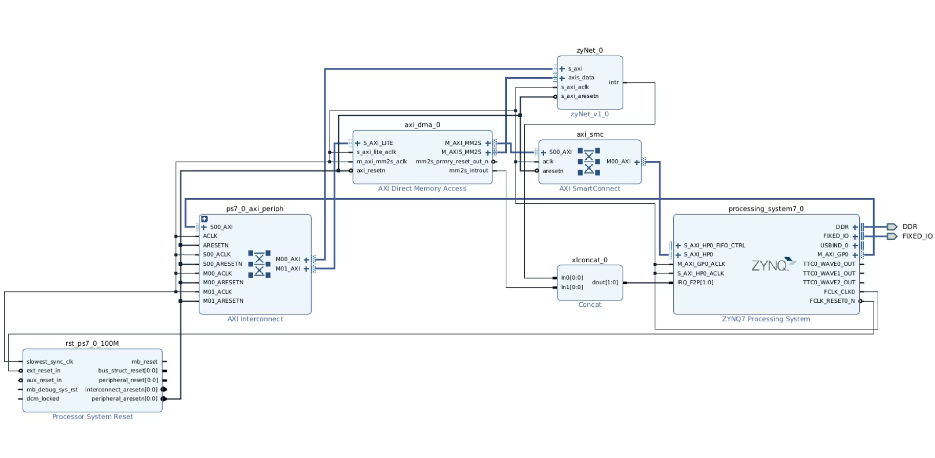
Block Design of MNIST implementation with Zynet

Slide 26
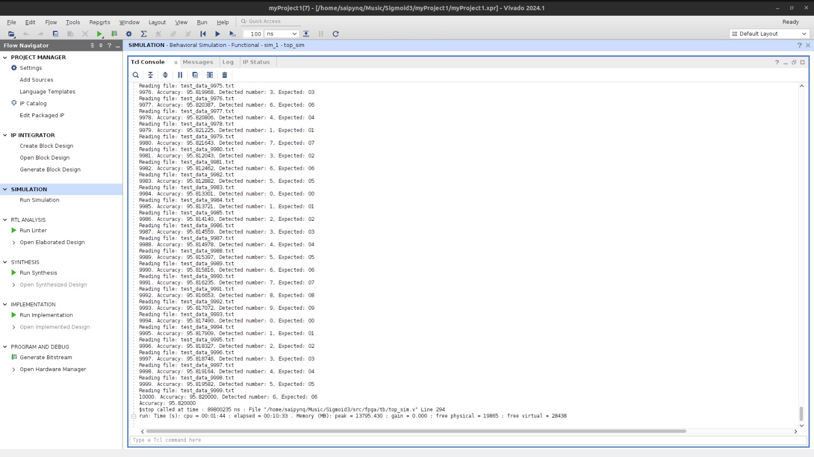
Current Simulation Results:

Slide 27
How the AI-Accelerated NIC Works?
Packet Reception
1
The FPGA receives the network packets from the network.
2
Data Transfer to PL
The data is then transferred to the PL, where the programmable logic handles real-time packet analysis.
AI Processing on FPGA
3
AI models, optimized for efficient execution, are implemented on the FPGA to analyze the data and detect potential threats or anomalies.
4
Feedback to Processing System (PS)
The results of the analysis, such as threat alerts or statistics, are sent back to the processing system (PS) for further actions.

Slide 28



Conclusion and Future Work
Laying a Strong Foundation
Future Objectives
Technical Priorities
The MTP-1 project has built a comprehensive understanding of FPGA-based development, paving the way for more advanced implementations.
The next phase (MTP-2) will focus on developing an AI-accelerated Network Interface Card (NIC) for real-time network traffic analytics.
Key focus areas include optimizing FPGA resources for complex AI workloads and demonstrating performance improvements over traditional CPU/GPU approaches.

Slide 29
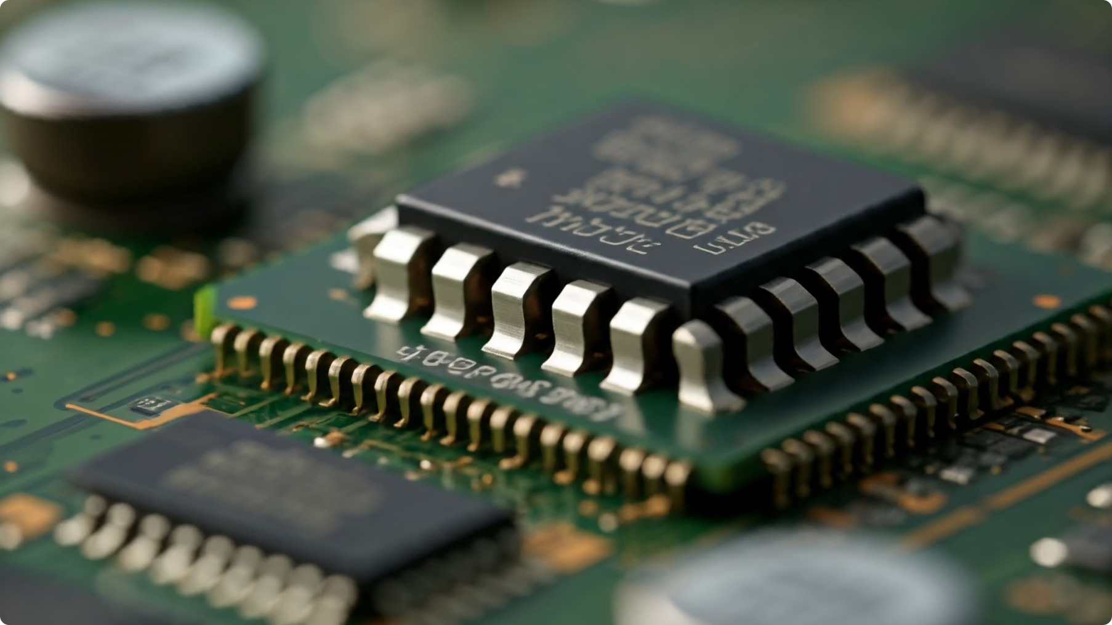
Thank You

